Slide 1

The Battle of Neighborhoods
Capstone project
week 2

Slide 2
Introduction: Business Problem
Introduction: Bayan Lepas has a lot of restaurants running in business. Japanese, Korea and HongKong are the most popular restaurants in Bayan Lepas.
Problem Statement: A seafood supplier from Bayan Lepas would like to know which type of asian cuisine restaurant is the most popular in Bayan Lepas so he can his distribution centre to supply his processed seafood according to popularity.
Target Audience: A seafood supplier who want to know the most popular restaurants in Bayan Lepas and the best location to set up the distribution center for processed seafood

Slide 3
Data AcquisitioN
To provide the information to the target audience, i will use foursquare API to collect location data to find out the highest number of restaurants among Japanese, Chinese and Korea Restaurants located in Bayan Lepas, Penang Malaysia.
Main data source used will be data from foursquare API to analyze existing restaurant in Bayan Lepas.
Location
Distance of neighboorhood from centroid of defined location, less than 10km
Restaurant style ( e.g Japan, Korea, Chinese)
Total Cout of restaurants by style

Slide 4
Data Acquisition (CON’T)
Key features obtained through FourSquare including longitude, latitude, categories, distance, name.
Latitude and longitude of Bayan Lepas : 5.295127, 100.2604606
Total 78 rows of entities including restaurant are returned when query with key words japan , Chinese and Korea.
46 from 78 query results are restaurants. Among them, 13 are Chinese restaurants, 16 are Japanese Restaurants and 7 are Korea style restaurants

Slide 5
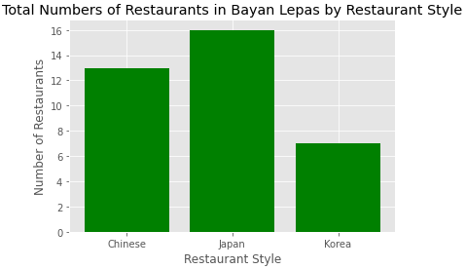
Methodology & Discussion
Total 46 of our interest restaurants are within 10km neighboring of centroid of Bayan Lepas.
Japanese style restaurants is the most popular restaurant. It has the highest number of restaurant within 10km neighboring of Bayan Lepas, followed by Chinese style and Korea style.

Slide 6
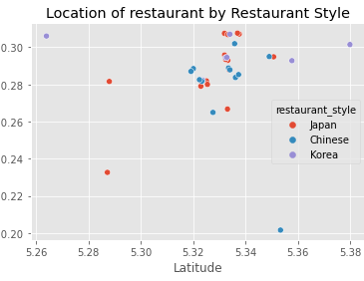
Methodology & Discussion
Most of Japanese, Chinese and Korea restaurants are located at latitude 5.32 to latitude 5.36, and longitude 100.26 to longitude 100.31.

Slide 7
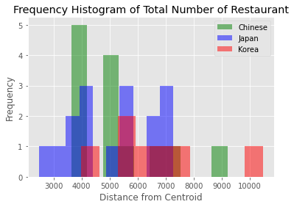
Methodology & Discussion
Majority of Chinese Restaurant are within 4km to 5km from centroid while Japanese restaurant are focus within distance 7km from centroid. Korean style restaurants are randomly distributed compare with other restaurants

Slide 8
Conclusion
Sea food provider should target Japanese style restaurant as their customer as they are the major player. The best location for him to set up his distribution centre will be within 2.5km to 7km from centroid of Bayan Lepas as all japanense restaurant are running the bussiness near to centroid of Bayan Lepas

